Slide 1
ZMU Academics - General Education
IOC Concept and Program Structure
December 2025

Slide 2

This document provides an overview of the ZMU GenEd program in addition to its IOC concept, curriculum and refinements
Provide overview of ZMU General Education (GenEd) Structure
1
Define IOC GenEd Concept
2
Present IOC GenEd Curriculum Overview
3
Discuss IOC GenEd Feedback and Refinements
4
Source: ZMU

Slide 3
Agenda
GenEd Overview
IOC GenEd Concept
IOC GenEd Curriculum
IOC GenEd Refinements

Slide 4

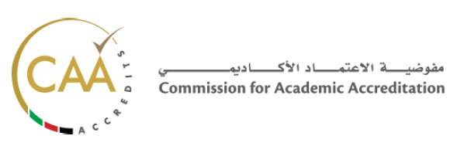










General Education (GenEd) is a CAA requirement to ensure that students are equipped with common knowledge and skills
General Education Program Overview
DEFINITION BY CAA
General Education is a broad foundation that equips every graduate with essential skills for the 21st century through at least 18 credits across humanities, social and natural sciences, and UAE-specific studies
GenEd REQUIRES 6 COURSES
(18 CREDIT HOURS)
OPPORTUNITIES FOR ZMU
Advanced English
Three Elective Courses
1
1
Align course content with ZMU leadership priorities while fully respecting Academic Partner (AP) academic autonomy
Domain
Humanities
Social and Behavioral Sciences
Natural Sciences
Quantitative Reasoning
Critical Thinking
Health
Sustainability
Technology & Society
2
Build a shared cross-Academic Partner curriculum that strengthens academic jointery and intellectual coherence
Emirati Studies
2
3
Link GenEd course outcomes that build towards one coherent leadership portfolio unique to each cadet
Innovation, Entrepreneurship
& Sustainability
3
4
Integrate academic leadership and skills content with ZMU’s Leadership Development System (developed across capstone assessments)

Slide 5




GenEd at ZMU has been adapted to ZMU priorities to achieve the ambitions of a bespoke ZMU GenEd program
ZMU General Education (GenEd) Concept
ZMU GenEd
Foundational courses delivered to all cadets as part of the ZMU Academic Program - regardless of AP affiliation - based on a ZMU-tailored curriculum with defined learning outcomes aligned to a military and defence context
ZMU GenEd is in line with ZMU Core Guiding Principles
Jointery
Academic
Proficiency
Common
Core
Pure
Academic
ZMU General Education Charter
Endorsed by ZMU Commandant
(Jun 2024)
ZMU GenEd Concept Benefits
Source: ZMU
Purpose-built GenEd curriculum meets the unique context of ZMU
Centralized partnership between ZMU and APs on course content
ZMU has more agency in defining the courses and expected course outcomes
ZMU GenEd concept has been aligned with the Academic Partners in May 2025 through ZMU GenEd Working Group (detailed in appendix)

Slide 6
Agenda
GenEd Overview
IOC GenEd Concept
IOC GenEd Curriculum
IOC GenEd Refinements

Slide 7



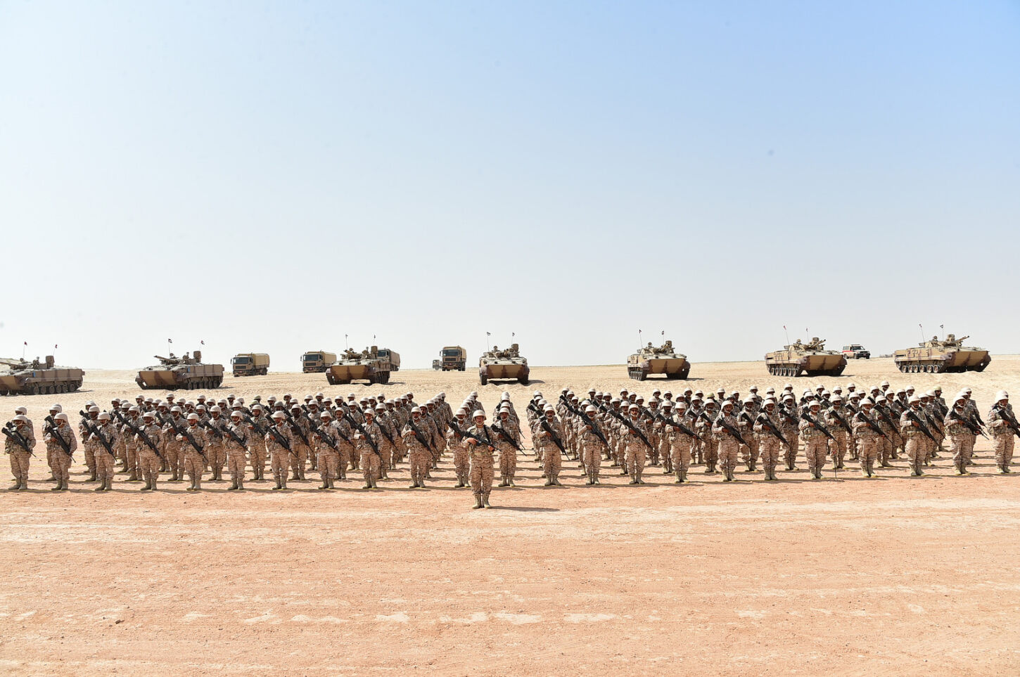


Development of ZMU IOC GenEd concept includes the list of courses with contextually relevant curricula and a process to develop courses
ZMU IOC General Education Concept Components
Non-Exhaustive
ZMU IOC GenEd Concept
DEVELOPMENT STRATEGY
Existing GenEd courses adapted to ZMU IOC GenEd through minimal rework, eliminating the need for CAA re-accreditation
Additional courses developed as ZMU IOC GenEd
Detailed on next slide
PROGRAM CURRICULUM
Unified learning objectives, outcomes and reading lists finalized for adapted ZMU IOC GenEd courses, integrating military context throughout
Adapted ZMU IOC GenEd courses planned to be delivered across different academic years within cadet program
DELIVERY
MODEL
ZMU IOC GenEd courses delivered individually by APs with jointery enabled through AP-aligned learning outcomes
COURSE DEVELOPMENT PROCESS
Concept
Development
Stakeholder Needs Identified and Aligned
Development of Academic Program
Curriculum Development and Validation
Implementation and Testing
Source: ZMU
CONTINUOUS STAKEHOLDER ENGAGEMENT AND ALIGNMENT

Slide 8
At IOC, two ZMU GenEd courses have been successfully implemented, and additional courses are being prepared for rollout
ZMU IOC General Education Development Strategy
Preliminary, Non-Exhaustive
ZMU IOC GenEd Courses
Progress Update
Military Context
English 1 – Writing
Course will be rolled-out across all three APs in 2026, incorporating feedback from 2025 pilot. Cadet and faculty review in Fall 2025
Focus on Leadership
Implemented
English 2 – Writing
Focus on Leadership
Implemented
Emirati Studies
SUAD assigned to design course in 2026, to be piloted by all APs in 2027
Focus on Regional Awareness and National Understanding
Innovation and Entrepreneurship
Focus on Leadership and innovation in military relevant settings
Psychology
Focus on critical thinking in defence-adjacent environments
Philosophy
Focus on situational ethics with military relevance
ZMU IOC GenEd Courses
Cadet Cohort Teaching Year (Preliminary)
2025
2026
2027
Y1 | Y2 | Y3
✓
✓
Y1 | Y2 | Y3
✓
✓
✓
✓
Y1 | Y2 | Y3
✓
✓
✓
✓
✓
 | ✓
English 1 – Writing
English 2 – Writing
Emirati studies
Innovation and Entrepreneurship
Psychology
Philosophy
Activation Plan
ZMU IOC GenEd Concept and Courses agreed to by RA, KU, and SUAD
✓
Offered across all APs
Source: ZMU
✓
Piloted by SUAD

Slide 9
Agenda
GenEd Overview
IOC GenEd Concept
IOC GenEd Curriculum
IOC GenEd Refinements

Slide 10




To ensure consistency and high-quality design, an overarching curriculum has been developed for each IOC GenEd course
ZMU IOC General Education Curriculum Components
IOC GenEd Course Curriculum Components
CURRICULUM COMPONENTS
Learning Objectives
Knowledge, skills and competencies acquired by cadet during the course
Target Outcomes
Measurable results applied or performed by a cadet after course completion
Suggested Reading List
Academic resources providing foundational knowledge, reinforcing course concepts
E.g., Develop clear and concise writing skills for military reports, briefs, and formal communication, …
E.g., Cadets will write persuasively from evidence in a variety of formats, …
E.g., Kidder, Rushworth, Moral Courage, …
Summary for each IOC GenEd course detailed below
TEACHING METHODOLOGY
Teaching methodologies to be defined by respective faculty for each Academic Partner delivering the course
Source: ZMU

Slide 11

Learning Objectives and Learning Outcomes are modified for a defence context ensuring ZMU GenEd supports cadets’ military education (1/2)
ZMU IOC General Education Curriculum Summary
Non-Exhaustive
English 1
English 2
Emirati Studies
Learning Objectives
Develop leadership focused foundational and complex military writing skills
Strengthen early analytical reading for leadership engagement
Understand academic integrity
Build clear, evidence-based arguments in written communication
Adapt writing for purpose and audience in leadership and military contexts
Interpret complex texts using strong analytical reading skills
Apply basic research and integrate sources effectively in writing tasks
Build foundational understanding of UAE history and compare diverse representations across sources
Connect Emirati identity and heritage to responsibilities of future officers
Explore how identity and values shape early leadership instincts
Learning Outcomes
Express leadership ideas with clarity and analysis
Conduct analysis of leadership media and text
Accurately summarize and paraphrase sources using basic evaluation skills
Produce structured analytical essays using clear claims, reasoning, and evidence
Critically assess sources and address assumptions and counterarguments in writing
Apply persuasive and ethical communication in military writings, including leadership
Explain the evolution of UAE development, governance, and social systems, through differing sources
Describe how heritage and identity influence cadet attitudes toward service and teamwork
Synthesize course insights through ZMU leadership development system “My Emirati Leadership Doctrine”
Source: ZMU
Detailed curriculum, including reading lists, are in appendix

Slide 12
Learning Objectives and Learning Outcomes are modified for a defence context ensuring ZMU GenEd supports cadets’ military education (2/2)
ZMU IOC General Education Curriculum Summary
Non-Exhaustive
Innovation and Entrepreneurship
Psychology
Philosophy
Learning Objectives
Introduce design thinking to help cadets define service or defence problems clearly
Strengthen skills in problem definition, idea generation, and solution
Encourage initiative, adaptability, and experimentation with a leadership mindset
Introduce core concepts in cognitive, social, and developmental psychology and link them to real cadet experience
Strengthen cadets’ understanding of bias, motivation, self-regulation and interpersonal influence to build leadership awareness
Build ability to analyze group dynamics, cohesion and communication patterns
Build ethical reasoning skills and examine moral traditions and perspective to analyze dilemmas in military context
Develop competence in applying ethical frameworks to assess moral dilemmas
Explore emerging ethical challenges to strengthen reasoning under future uncertainty
Learning Outcomes
Apply design-thinking process to identify needs and generate solutions using feasibility and impact criteria
Demonstrate teamwork, communication, and project-planning skills
Connect a real challenge to a proposed solution through ZMU leadership development system “Innovation for Service Project”
Explain, relate and apply psychological processes to demonstrate leadership and decision-making
Analyze group dynamics and behavior using defined psychological concepts
Integrate insights into personal identity through ZMU leadership development system “My Leadership Behavioral Doctrine”
Evaluate arguments and assess competing moral claims in leadership cases
Apply ethical frameworks to analyze dilemmas involving conflict, pressure, or new technologies
Synthesize course value into a personal identity through ZMU leadership development system “Ethical Leadership Framework”
Source: ZMU
Detailed curriculum, including reading lists, are in appendix

Slide 13
Agenda
GenEd Overview
IOC GenEd Concept
IOC GenEd Curriculum
IOC GenEd Refinements

Slide 14


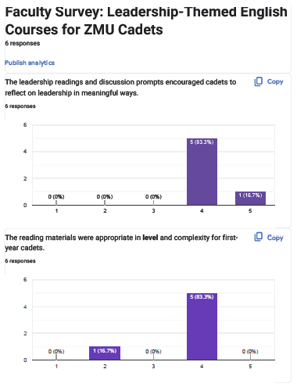
Systematic evaluation assesses whether the ZMU IOC GenEd courses deliver on their objectives
GenEd Feedback Approach
Purpose of GenEd Feedback
GenEd Assessment Evaluation Components
Feedback Domains Assessed
GenEd feedback was received by content delivering faculty through structured surveys
Systematic evaluation confirms whether the GenEd courses deliver on the learning objectives and provide a consistent experience across APs
Course Content | Methodology
Learning Experience | Learning Outcomes
Relevance and volume of course content
Course Delivery
Cadet engagement through delivery methodology
Cadet Learning
Cadets’ perceived value and learning
Transferable practices that translate to cadet skills
Deep dive below
Source: ZMU

Slide 15





The Q4 2025 survey reflects successful course delivery and cadet learning practices and identifies proposed modifications for 2026
GenEd 2025 IOC Survey Results for English 1 and English 2
Course Delivery
Cadet Learning
COURSE CONTENT
Cadets were drawn to pragmatic topics on leadership and military themes that led to personal reflection
Volume and pace of course content was challenging for some cadets, with feedback that UAE/MENA content was limited
DELIVERY METHODOLOGY
Using multimodal materials (case studies, podcasts etc.) supported learning and writing development
Topics, such as transactional versus transformational concepts, were disengaging for cadets when delivered as pure theory
LEARNING EXPERIENCE
Comprehension of complex leadership topics benefited greatly from shorter readings followed by group discussions
Limited alignment between cadet military training and course curriculum presented a missed opportunity to unify cadets’ overarching military experience
LEARNING OUTCOMES
Faculty observed consistency in argumentative writing, shared standard of academic integrity and, analytical writing through practices like evidence-driven framework and structured paraphrasing
Cadets perceived limited practical application due to limited contextually relevant materials
GenEd 2025 Survey Results
Source: ZMU, Academic Partners
Proposed Modifications
Increase UAE/MENA materials, military case studies, and pragmatic course content
Include additional visual aids and interviews with UAE military officers to enhance cadet engagement
Introduce workshops between Military Training Wing and APs to unify cadet learning outcomes
Include greater contextually relevant topics like social media, technology etc. to increase cadet interest
Academic Partners have suggested increased cross-AP collaboration throughout course delivery for continuous alignment to address feedback throughout the semester

Slide 16
Next steps include briefing ZMU Leadership on IOC GenEd, updating ENG1 and ENG2 course curriculum and finalizing 2026 piloted courses curricula
Next Steps
Step
1
Step
2
Step
3
Brief ZMU Leadership on IOC GenEd update and refinements
Finalize English 1 and English 2 Curriculum based on faculty feedback
Align with Academic Partners on final curriculum for Emirati Studies and Philosophy
Source: ZMU

Slide 18
Appendix
ZMU General Education Working Group Overview
ZMU GenEd Course Curriculum

Slide 19
Appendix
ZMU General Education Working Group Overview
ZMU GenEd Course Curriculum

Slide 20
ZMU General Education Curriculum (GenEd) Working Group has defined objectives and membership from all Academic Partners
ZMU GenEd Objective
To develop and implement a unified General Education (GenEd) framework for IOC and FOC that designs core curriculum for ZMU officer cadets and develop an assessment and feedback framework for continuous improvement
Membership
ZMU | KU | SUAD | RA | Other
Dr. Shamma Al Naqbi (ZMU Directorate of Academic Affairs) | Dr. Ted Burkett (Director, General Education Program) | Proscovia Svard (Professor) Celia Ouali (Professor) Dr. Alexandra Dimitri (Project Lead ZMU) | Dr. Deena Elsori (Program Chair, General Education) Dr. Warren Chin (Program Chair, Defence and Security) | Permanent Members may invite additional functional representatives or other support as needed based on meeting agenda
2025 ZMU GenEd Working Group
Source: ZMU

Slide 21
Appendix
ZMU General Education Working Group Overview
ZMU GenEd Course Curriculum

Slide 22



English 1 - Writing
English 1 builds clear, disciplined writing and early analytical skills essential for effective communication and leadership as future officers
ZMU IOC General Education Curriculum – English 1
Non-Exhaustive
Build foundational academic and professional military writing skills for clear communication as future officers
Develop leadership-focused expression, helping cadets articulate ideas with clarity, purpose, considering military communication norms
Strengthen early analytical reading and source-evaluation habits that support engagement with leadership and regional texts
Encourage revision, reflection, and structured argumentation, preparing cadets for more complex writing, speaking, and briefing tasks in later courses
Understand key principles of academic integrity in writing
Express ideas with clarity and purpose across leadership genre, demonstrating analysis through written formats including brief reflections, personal leadership statements, and short explanatory pieces
Analyze and contrast an array of writings and media on leadership
Summarize and interpret texts using accurate paraphrasing, key-idea identification, and early source-evaluation techniques appropriate for first-year cadets
“Sheikh Zayed: The Making of a Great Leader” (Gulf News, 2018)
“In Praise of Followers” - Robert Kelley (HBR)
“Why Emotional Intelligence Is Crucial for Effective Leadership” (Forbes)
“Why Good Leaders Make You Feel Safe” - Simon Sinek (TED Talk)
“Charisma in Politics” - Zsolt Feher (Science of Personality podcast)
Excerpts from David Hackworth’s About Face
Excerpts from Anton Myrer’s Once an Eagle
Learning Objectives
Learning Outcomes
Reading List for 2026
Source: ZMU, Academic Partners

Slide 23
English 2 - Writing
English 2 strengthens cadets’ ability to construct evidence-based, leadership-relevant writing for academic and military contexts
ZMU IOC General Education Curriculum – English 2
Non-Exhaustive
Strengthen cadets’ ability to construct clear, logical arguments supported by evidence and sound reasoning
Introduce rhetorical awareness and audience sensitivity through leadership- and military-relevant writing tasks
Deepen analytical reading skills by engaging with more complex texts, viewpoints, and varied source types
Develop disciplined research and source-integration practices through applied assignments, including expository writing and leadership-focused tasks
Write structured analytical essays presenting clear claims, coherent reasoning, and well-integrated evidence across multiple sources
Produce writing that critically evaluates source credibility, assesses assumptions, and responds to counterarguments with clarity and discipline
Apply persuasive and ethical communication skills in leadership-oriented genres, including expository responses to military scenarios and decision briefs
“Sheikh Mohammed's 10 Important Rules for Leadership” (Khaleej Times, 2019)
“Servant Leadership” - Admiral Linda Fagan, ReThinking with Adam Grant podcast
“Great Teams Are About Personalities, Not Just Skills” (HBR)
“Will Your Personality Make You a Successful Employee or Leader?” (Psychology Today)
“Transactional vs. Transformational Leadership” (Economic Times)
“The Study of Leadership Theories: Great Leaders Are Made, Not Born” (Law Practice Magazine)
Learning Objectives
Learning Outcomes
Reading List for 2026
Source: ZMU, Academic Partners

Slide 24
Emirati Studies
Emirati Studies is a leadership-focused study of how Emirati identity, heritage, and national vision shape the responsibilities of future officers
ZMU IOC General Education Curriculum – Emirati Studies
Preliminary, Non-Exhaustive
Build foundational understanding of UAE history, society, institutions, and values, through diverse sources
Connect heritage, unity, and national vision to the responsibilities of future officers
Develop historical-narrative analysis skills by comparing how different sources represent the UAE and its national stories
Explore how identity and values inform early leadership instincts, laying groundwork for later ethical, leadership, and strategic learning
Explain how UAE development, governance, and social systems have evolved
Describe how elements of Emirati history and heritage shape their early attitudes toward service, teamwork, and responsibility as cadets
Analyze differing representations of Emirati identity across various sources
Synthesize course insights into a personalized “My Emirati Leadership Doctrine,” articulating their identity, values, and leadership philosophy, grounded in Sheikh Zayed’s legacy
“MOE Contemporary Emirati Studies Textbook” (2024 edition)
UAE Vision 2021, We the UAE 2031, Centennial 2071
Selected MOFA briefs on UAE domestic and foreign policy
Excerpts from UAE leadership speeches on identity, unity, and service
Government archival videos on UAE history, development, and heritage
Curated national narratives from official media and international outlets
Learning Objectives
Learning Outcomes
Reading List
Preliminary Curriculum to be piloted in 2026 by SUAD
Source: ZMU, SUAD

Slide 25
Innovation and Entrepreneurship
Innovation & Entrepreneurship course introduces cadets to design-thinking and problem-solving
ZMU IOC General Education Curriculum – Innovation and Entrepreneurship
Preliminary, Non-Exhaustive
Introduce design thinking to help cadets identify and define defence- or service-related problems with clarity and purpose
Strengthen skills in defining problems, generating ideas, and evaluating solution pathways
Encourage initiative, adaptability, and thoughtful experimentation in service-oriented contexts
Cultivate a leadership mindset that links creativity, initiative, and service, with innovation
Apply a structured design-thinking process to identify a service or defence need, analyze constraints, and generate a solution
Demonstrate effective teamwork, communication, and project-planning skills through collaborative problem-solving tasks
Evaluate solution options using criteria such as feasibility, impact, alignment with UAE priorities, and
Produce a final Innovation for Service Project that links a real challenge to a proposed solution and articulates how their approach reflects their emerging leadership identity
“Change by Design” - Tim Brown
“Creative Confidence” - Tom Kelley & David Kelley
“The Innovator’s DNA” - Jeff Dyer, Hal Gregersen & Clayton Christensen
“The Art of Innovation” - Tom Kelley
“Flashes of Thought” - H.H. Sheikh Mohammed bin Rashid Al Maktoum
“Design Thinking Comes of Age” - Jon Kolko
“Start With Why” - Simon Sinek
“Range: How Generalists Triumph in a Specialized World” - David Epstein
Learning Objectives
Learning Outcomes
Reading List
Suggested Curriculum – Pending finalization by SUAD
Source: ZMU

Slide 26
Psychology
Psychology course provides cadets the core psychological tools essential for effective leadership by analyzing how people think and behave
ZMU IOC General Education Curriculum – Psychology
Preliminary, Non-Exhaustive
Introduce core concepts in cognitive, social, and developmental psychology that shape how individuals think, perceive, decide, and act
Strengthen cadets’ understanding of bias, motivation, self-regulation, and interpersonal influence to build foundational leadership awareness
Develop the ability to analyze group dynamics, cohesion, and communication patterns
Prepare cadets for advanced leadership training by linking behavioral science to real cadet-life scenarios
Explain key psychological processes - including bias, motivation, and emotion - and relate them to leadership and decision-making scenarios
Analyze team behavior and group dynamics using frameworks such as self-efficacy, group development, and psychological safety
Apply psychological concepts to evaluate decisions made under stress, uncertainty, or social pressure
Produce a “My Leadership Behavioral Doctrine” that integrates course insights with their identity and responsibilities as future officers
“Mistakes Were Made (but Not by Me): Why We Justify Foolish Beliefs, Bad Decisions and Hurtful Acts” - Tavris and Aronson
“Thinking, Fast and Slow” - Daniel Kahneman
“Leadership and Self-Deception” - Arbinger Institute
“The Social Animal” - Elliot Aronson
“Mindset” - Carol Dweck
“Self-Efficacy: Toward a Unifying Theory of Behavioral Chang” - Albert Bandura
“Developmental Sequence in Small Groups” - Bruce Tuckman
“Psychological Safety and Learning Behavior in Work Teams” - Amy Edmondson
Learning Objectives
Learning Outcomes
Reading List
Suggested Curriculum – Pending finalization by SUAD
Source: ZMU

Slide 27
Philosophy
Philosophy course equips cadets with ethical reasoning tools to analyze various dilemmas and apply them on real-life military scenarios
ZMU IOC General Education Curriculum – Philosophy
Preliminary, Non-Exhaustive
Build foundational ethical reasoning skills through analysis of dilemmas involving loyalty, responsibility, and uncertainty in military contexts
Examine diverse moral traditions and perspectives to deepen understanding of virtue, character, and leadership
Develop competence in using structured ethical frameworks to analyze dilemmas involving loyalty, responsibility, and uncertainty
Explore emerging ethical challenges such as AI and climate change, developing the capacity to navigate future uncertainty
Evaluate arguments, identify assumptions, and assess competing moral claims in philosophical and applied leadership cases
Apply ethical frameworks to analyze moral dilemmas involving conflicting expectations, group pressures, or emerging technologies, demonstrating clarity of reasoning
Articulate a personal “Ethical Leadership Framework” synthesizing course readings, values, and cadet identity as future UAE officers
“The Coming Wave: AI, Power, and Our Future” - Mustafa Suleyman
“Defining Moments: When Managers Must Choose Between Right and Right” - Joseph Badaracco
“Just and Unjust Wars” - Michael Walzer (5th edition)
“Revival of the Religious Sciences - The Formation of Character” - Al-Ghazali (Book XXII)
“The Ethical Algorithm” - Kears and Roth
“Moral Courage” - Rushworth Kidder
“A Perfect Moral Storm: The Ethical Tragedy of Climate Chang” - Stephen M. Gardiner
Learning Objectives
Learning Outcomes
Reading List
Preliminary Curriculum to be piloted in 2026 by SUAD
Source: ZMU, SUAD

